Slide 1
Governance and Compliance

Slide 2
Management Groups
Organizational alignment for your Azure subscriptions through custom hierarchies and grouping
Targeting of policies and spend budgets across subscriptions and inheritance down the hierarchies
Compliance and cost reporting by organization

Slide 3
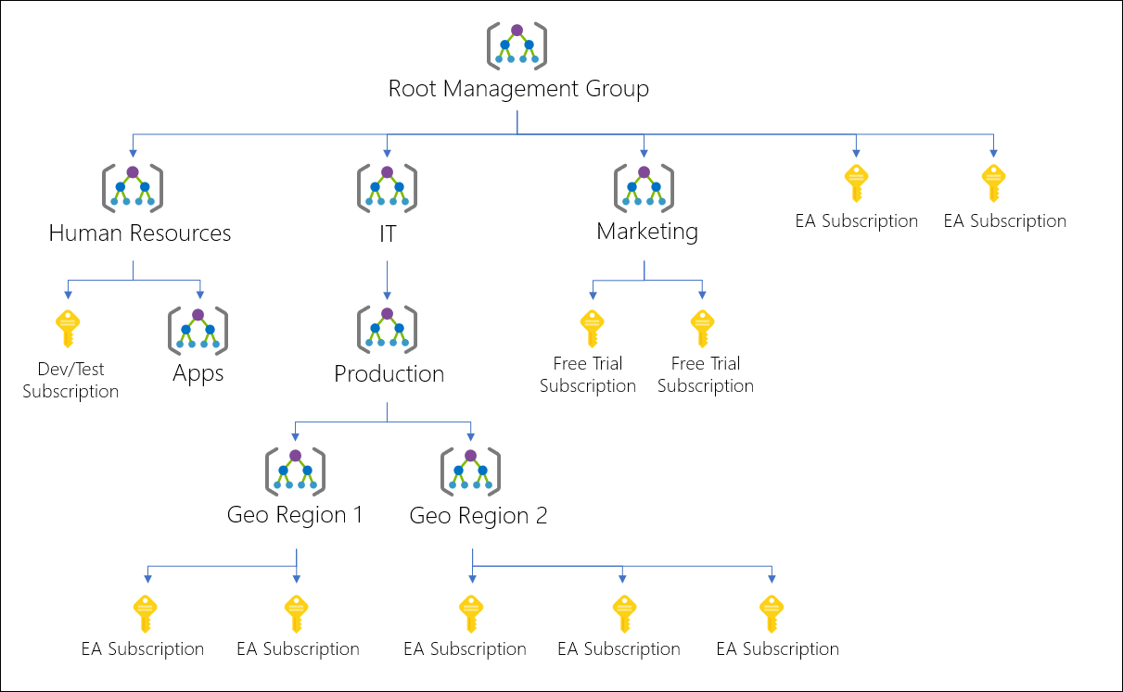

Slide 4
Azure Subscriptions
Logical unit of Azure services that is linked to an Azure account.
Users, groups and service principles
Azure resources in resource groups
Authentication
& Authorization
Azure Subscriptions
Azure Active Directory

Slide 5
Getting a Subscription
Enterprise Agreement – Upfront monetary commitment
Resellers – Open Licensing Program
Partners – Microsoft partner who can design and implement azure cloud solutions
Personal
Free Trial Account
Pay As You Go
Student Subscription

Slide 6
Check Resource Limits
Check under the subscription

Slide 7
Cost Management and Billing
Get insights on cost and utilization
Cost over time
Forecast
Budgets

Slide 8
RG 1
Resource 1
Resource 2
RG 2
Resource 3
Resource 4
Subscription 2
Subscription 1
RG 3
RG 4
Resource 5
Resource 7
Management Group
Resource 6
Resource 8

